Slide 1
6

Slide 2
PROBLEM
Deaf and hard of hearing people are often left out of key nuanced information that is conveyed through audio in digital spaces
SOLUTION
ALTiO is a social media platform that encourages and provides drawings as visual supplements for interpreting audio–providing alternative options for everyone to experience content

Slide 3
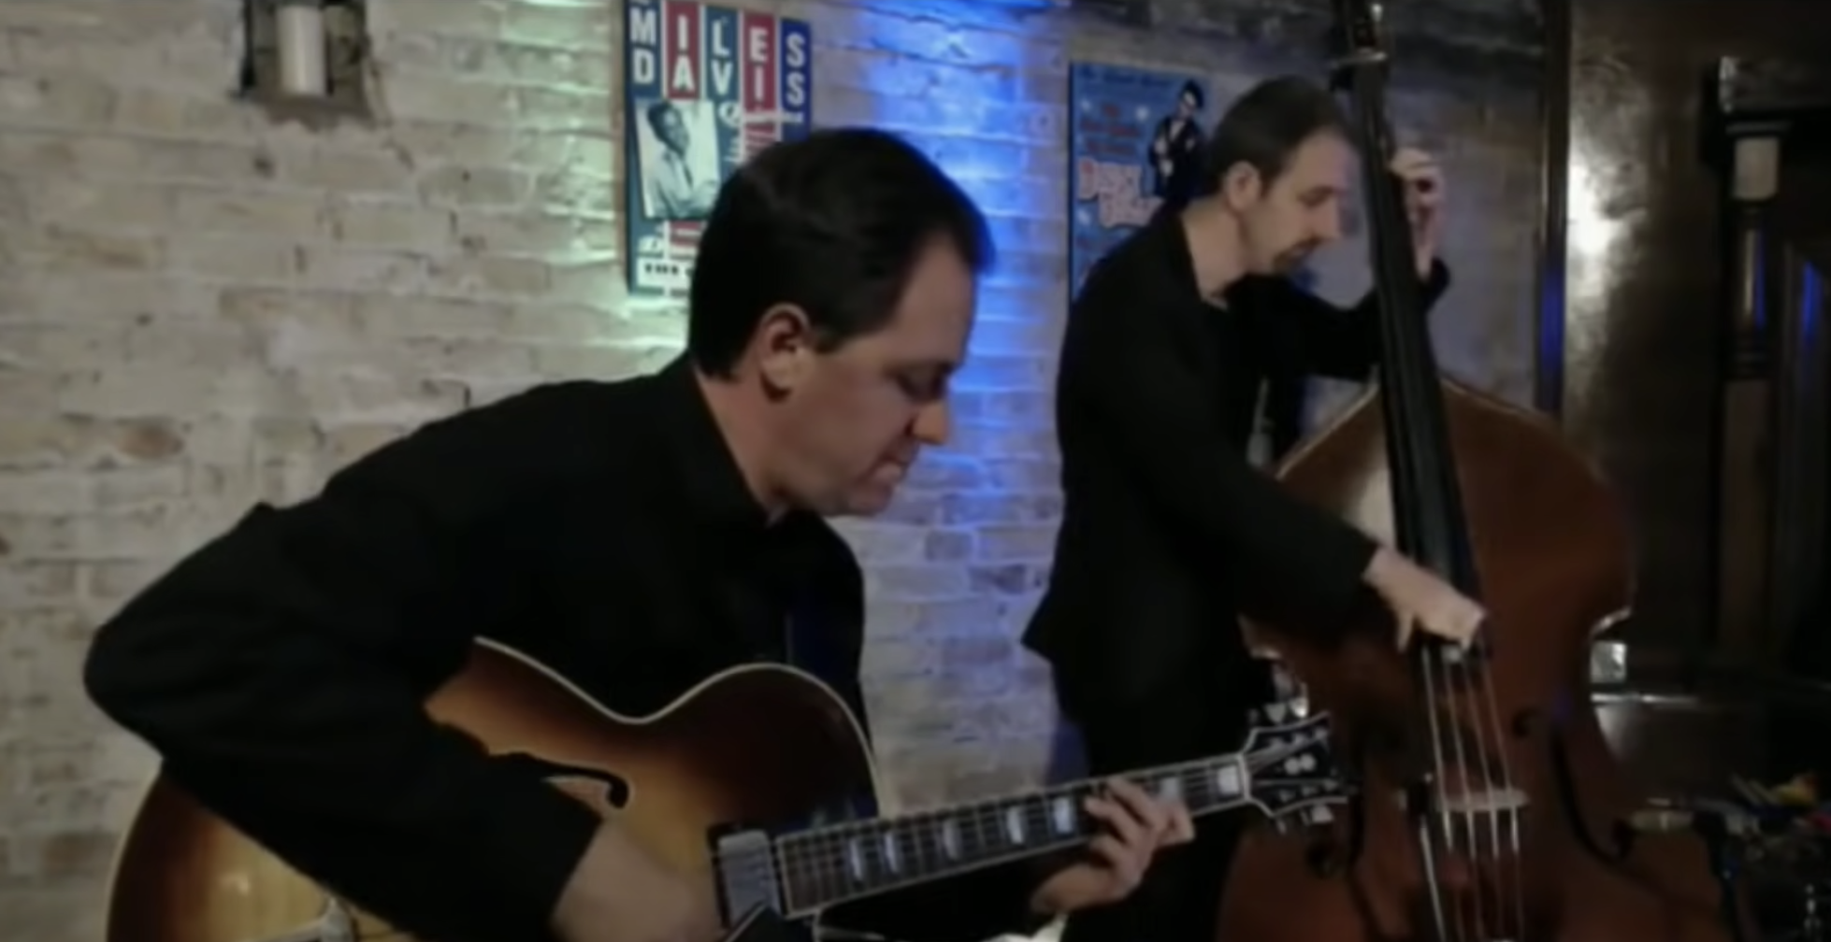
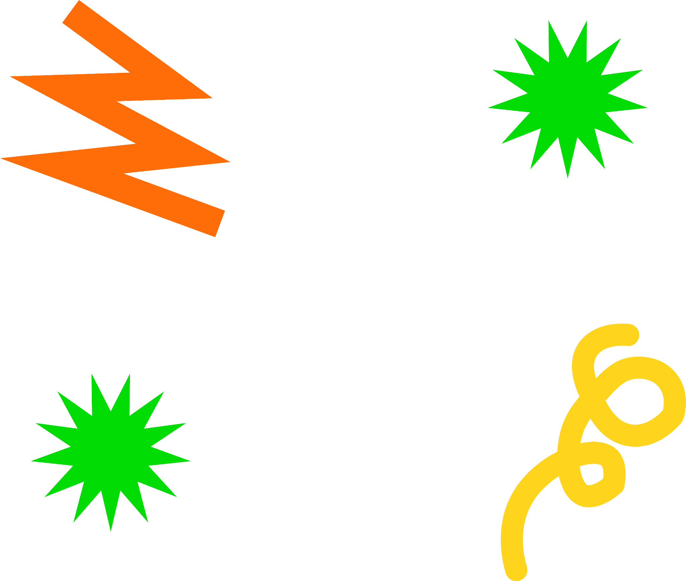
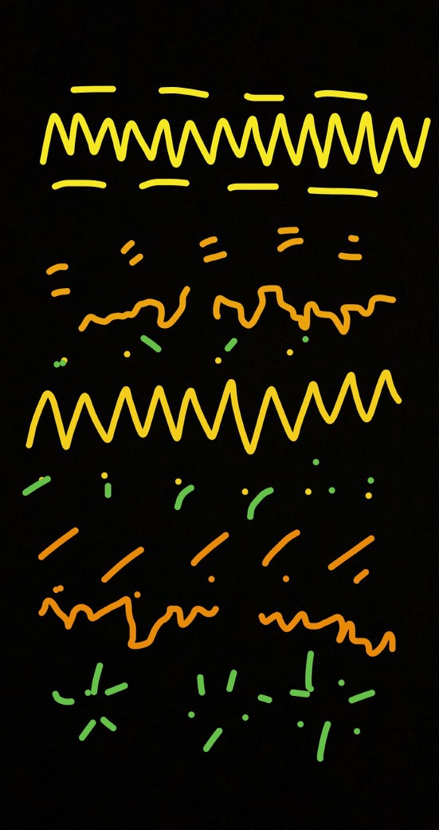
ALTiO
NOUN
a combination of alternative and audio that denotes a visual interpretation of audio which can convey a more emotional or descriptive meaning
than captioning

Slide 4
OVERVIEW
HEURISTIC EVAL. RESULTS
REVISED DESIGN
HI-FI IMPLEMENTATION
HI-FI DEMO

Slide 5
HEURISTIC EVAL. RESULTS
In Summary
H3: User Control & Freedom
Arduous uploading sequence
4 Violations
H4: Consistency & Standards
Back or return buttons
19 Violations
H10: Help & Documentation
Onboarding confusion
11 Violations

Slide 6
HEURISTIC EVAL. RESULTS
Severity 4 Issues
H3: User Control & Freedom
Allowing users to select an audio and choose a video to accompany it
H5: Error Prevention
Prompting the user to save a draft in the Create screen
H13: Value Alignment
Specifically mentioning the Deaf and hard of hearing community
Total: 4

Slide 7
HEURISTIC EVAL. RESULTS
Severity 3 Issues
H3: User Control & Freedom
Back and redo button affordability
H4: Consistency & Standards, H6: Recognition not Recall
Miscommunication about Create task
H10: Help & Documentation
Scrollability clarity
H11: Accessible
Increase font size and weight
Total: 11

Slide 8
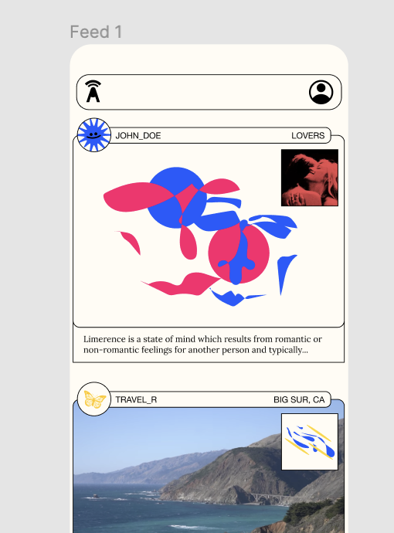
REVISED UI DESIGN
SEARCH BAR
H4 Consistency and Standards: The bar on top of the home page feels like it should be a search bar, but there’s nothing indicating it as such, and it’s not interactable.

Slide 9
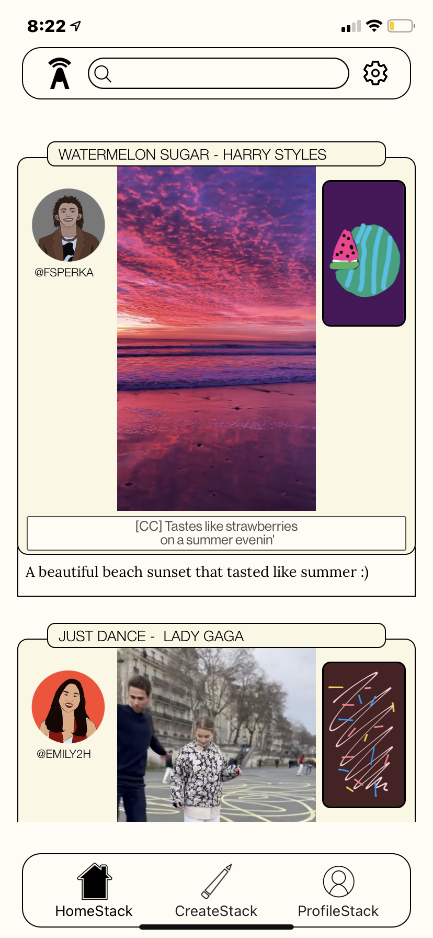
REVISED UI DESIGN
SEARCH BAR
Revision: Taskbar has been rearranged so that “Search” now resides at the top of the screen

Slide 10
REVISED UI DESIGN
TASK BAR
H1 Visibility of System Status: Tab status: It was unclear that the first feed that we encountered (after the onboarding directions) was the home feed. As I was navigating through tabs, I wanted to get back to that screen but didn’t realize that it was the home tab until trial by error. It was generally unclear visually what tab I was on.

Slide 11
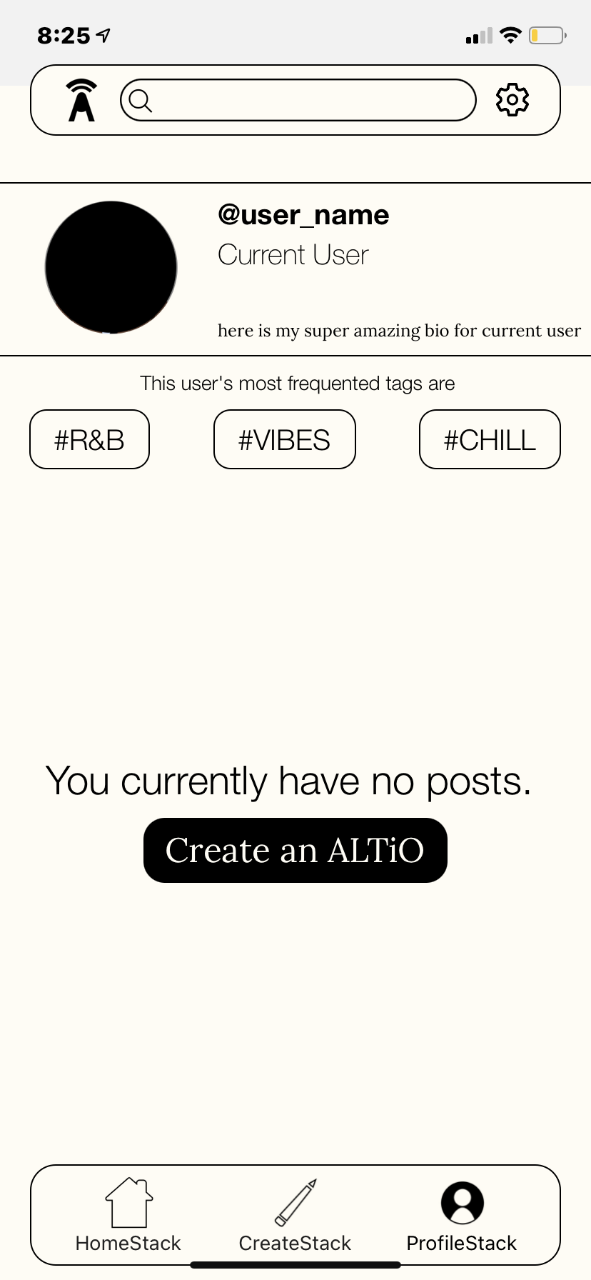
REVISED UI DESIGN
TASK BAR
Revision: Depending on the screen you’re on, the icon on the taskbar will change to inform you of your place

Slide 12
REVISED UI DESIGN
ONBOARDING SEQUENCE
H2 Match Between System and the Real World: The app references “your ALTiO” and prompts the user for “your ALTiO’s name” and to “give your ALTiO a caption,” but the experience never explained what an ALTiO is. Is a drawing automatically an ALTiO, or is there more to it?
H5 Error Prevention: On the onboarding screen about clarifying drawings, the user can click “continue” before tapping on the “1,” “2,” and “3” buttons that reveal drawing clarifications, and there is no indication that the buttons on the drawing are even clickable. This means the user can easily skip this onboarding screen without understanding this crucial aspect of the app.
H10 Help and Documentation: It is unclear why a video upload is necessary or encouraged if the user is creating their own visual representations of audio. Explain in the onboarding flow what the purpose of uploading video content is.

Slide 13
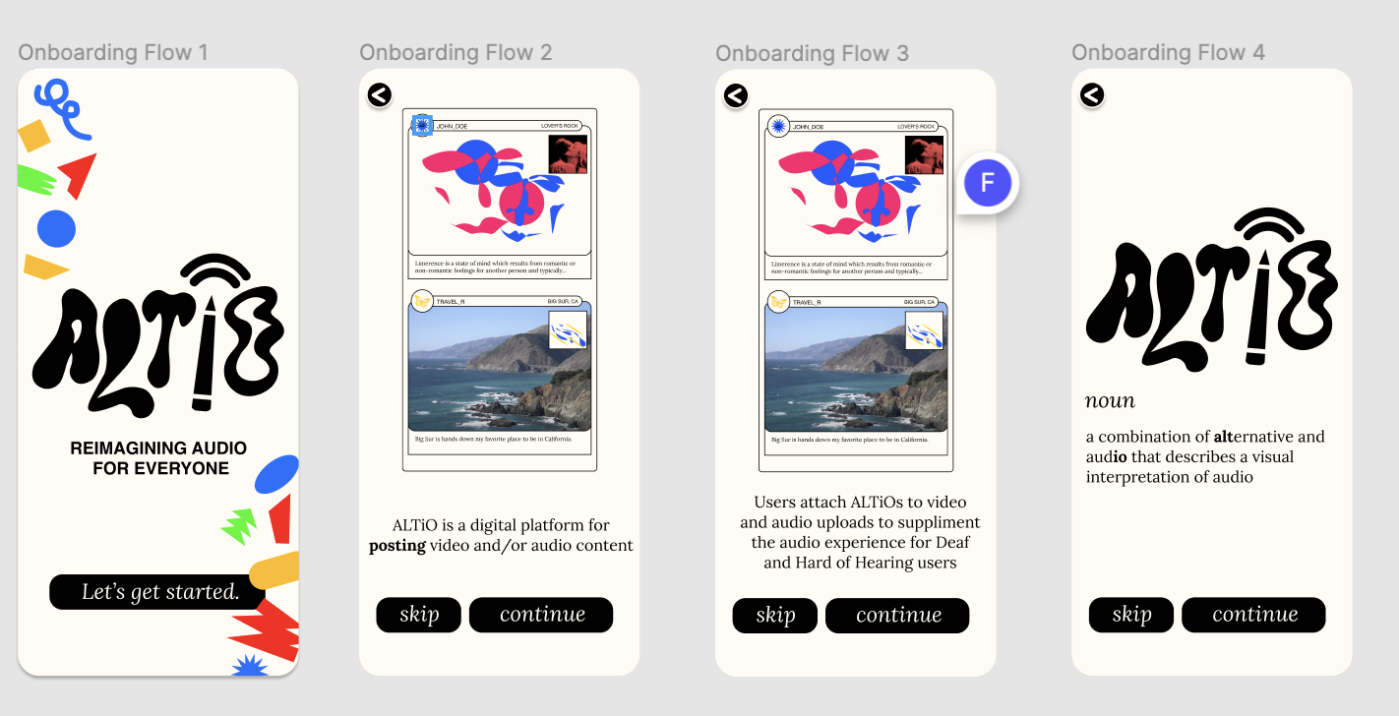
REVISED UI DESIGN
ONBOARDING SEQUENCE
Revision:

Slide 14
REVISED UI DESIGN
ONBOARDING ACCESS
H6 Recognition not Recall: It’s not possible to access the onboarding screens after reviewing them once. This means that a user cannot review the onboarding flow after the first time.
Make the onboarding flow visible and accessible from anywhere in the app.

Slide 15
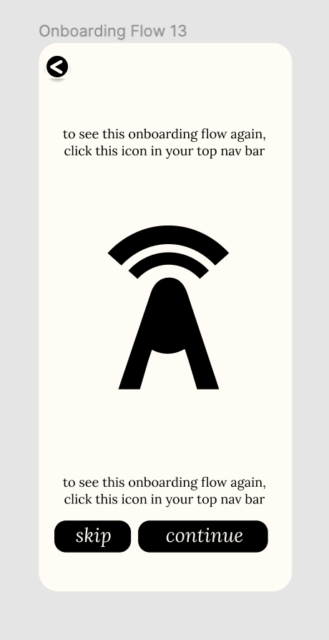
REVISED UI DESIGN
ONBOARDING ACCESS
Revision: Added a screen during the onboarding process that alerts the user that the tutorial can be seen again

Slide 16
REVISED UI DESIGN
BACK BUTTON
H3 User Control and Freedom: Multiple screens are missing back buttons. For example, there is no back button on the expanded view of the post, the expanded view of the tag screen, or the onboarding screens, which makes it challenging for users to navigate through the app and return to their previous position.

Slide 17
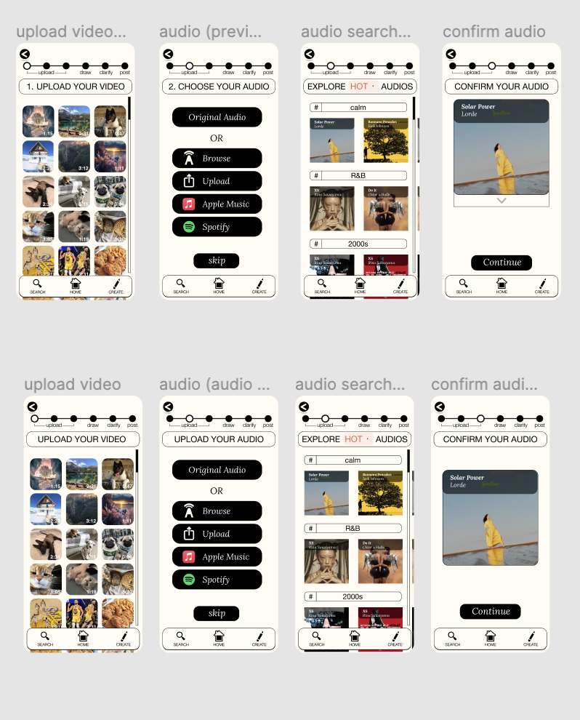
REVISED UI DESIGN
BACK BUTTON
Revision: Back buttons added to screens that
are sequential

Slide 18
HI-FI IMPLEMENTATION
React Native
Figma
Adobe Suite

Slide 19
HI-FI HARD CODED DATA
WIZARD OF OZ
Users
Usernames, User Profiles & Information
Audio Files
Songs, videos
Captions and Posts

Slide 20
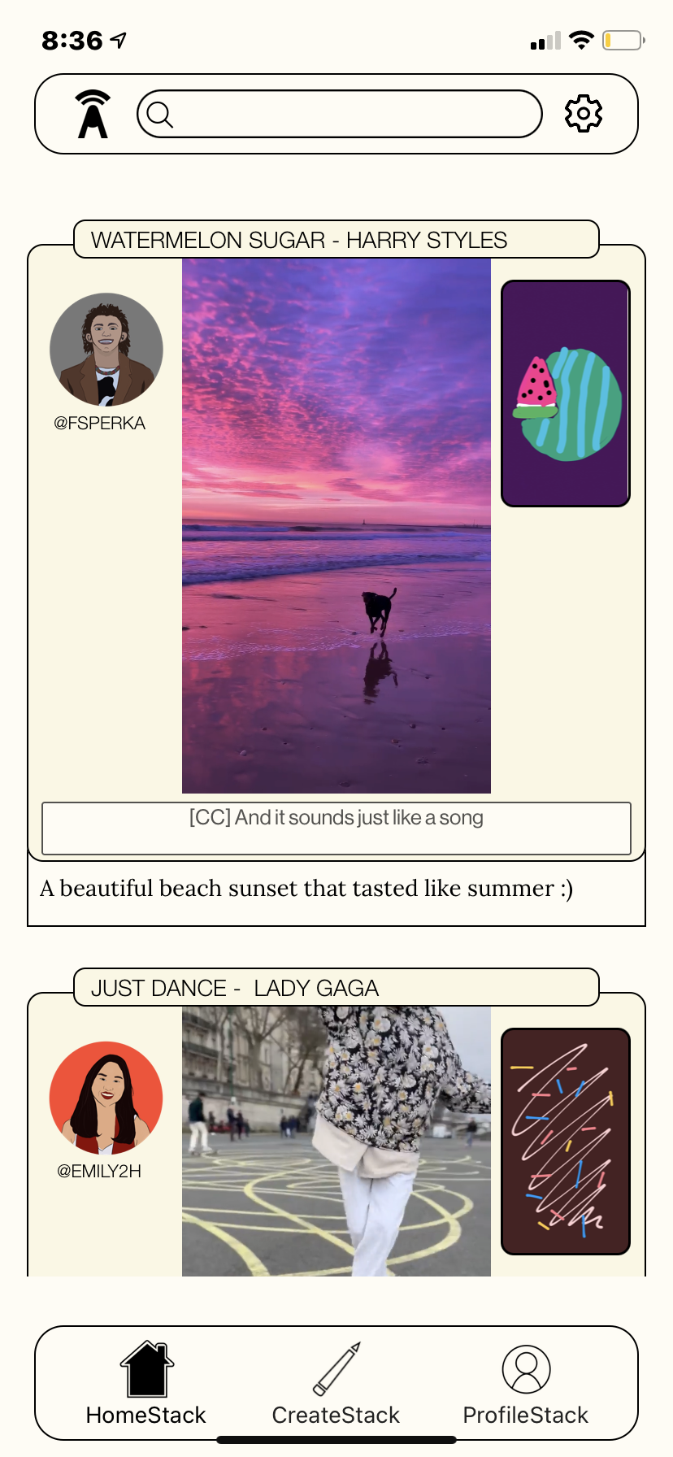
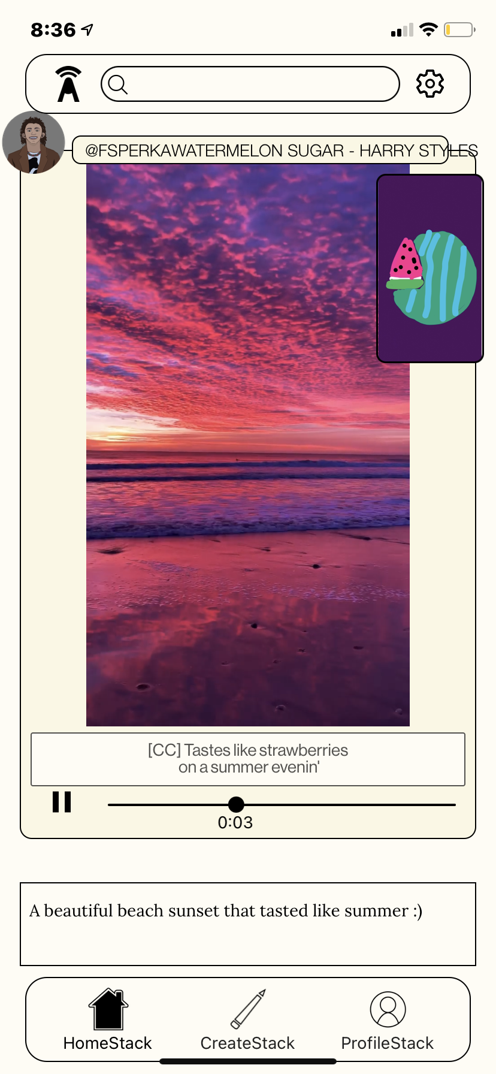
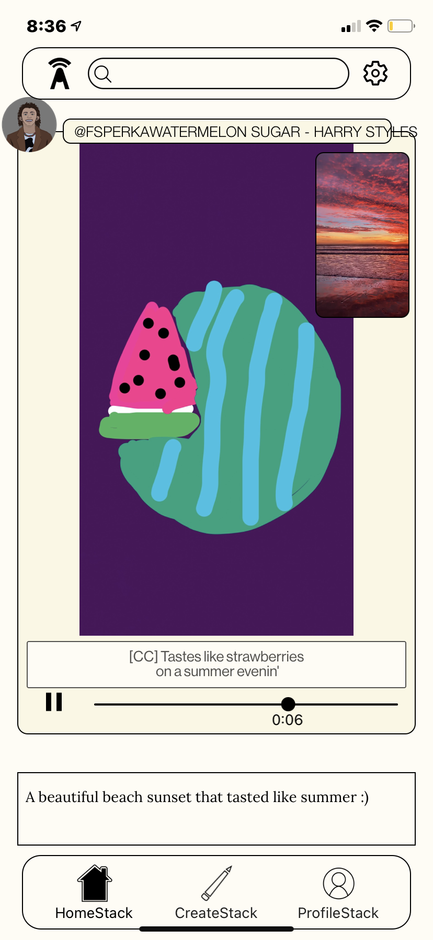
HI-FI TASK 3
COMPLEX TASK: INTERACTING WITH ALTiOs, PROFILES, AND TAGS

Slide 21
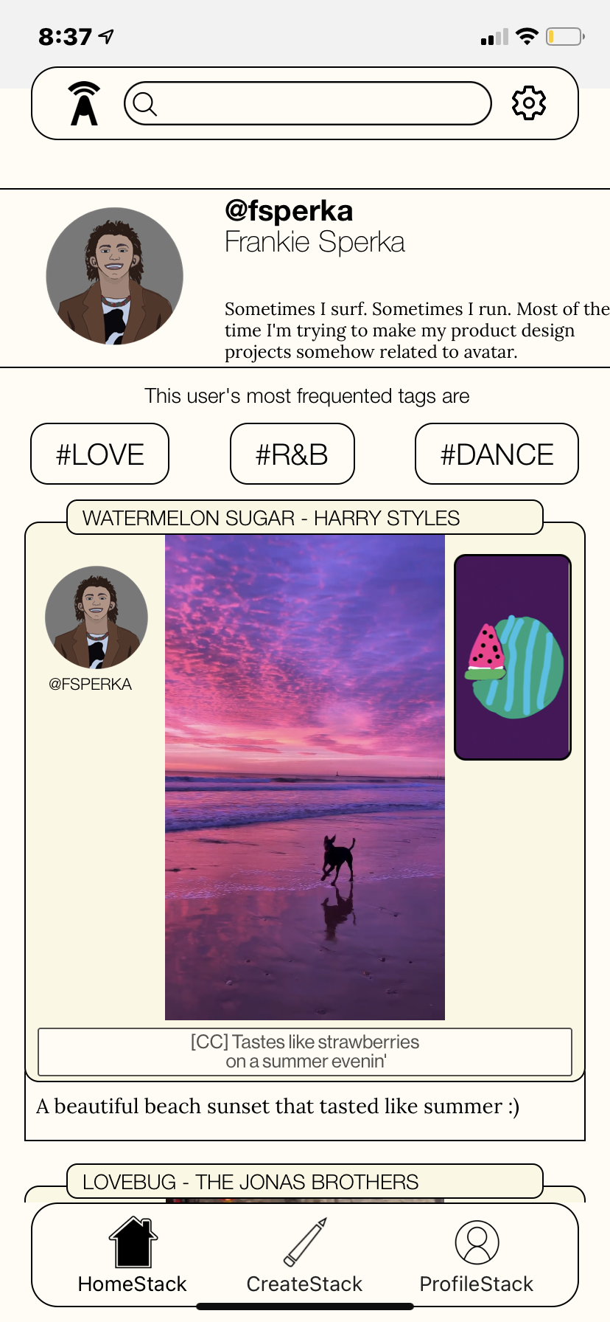
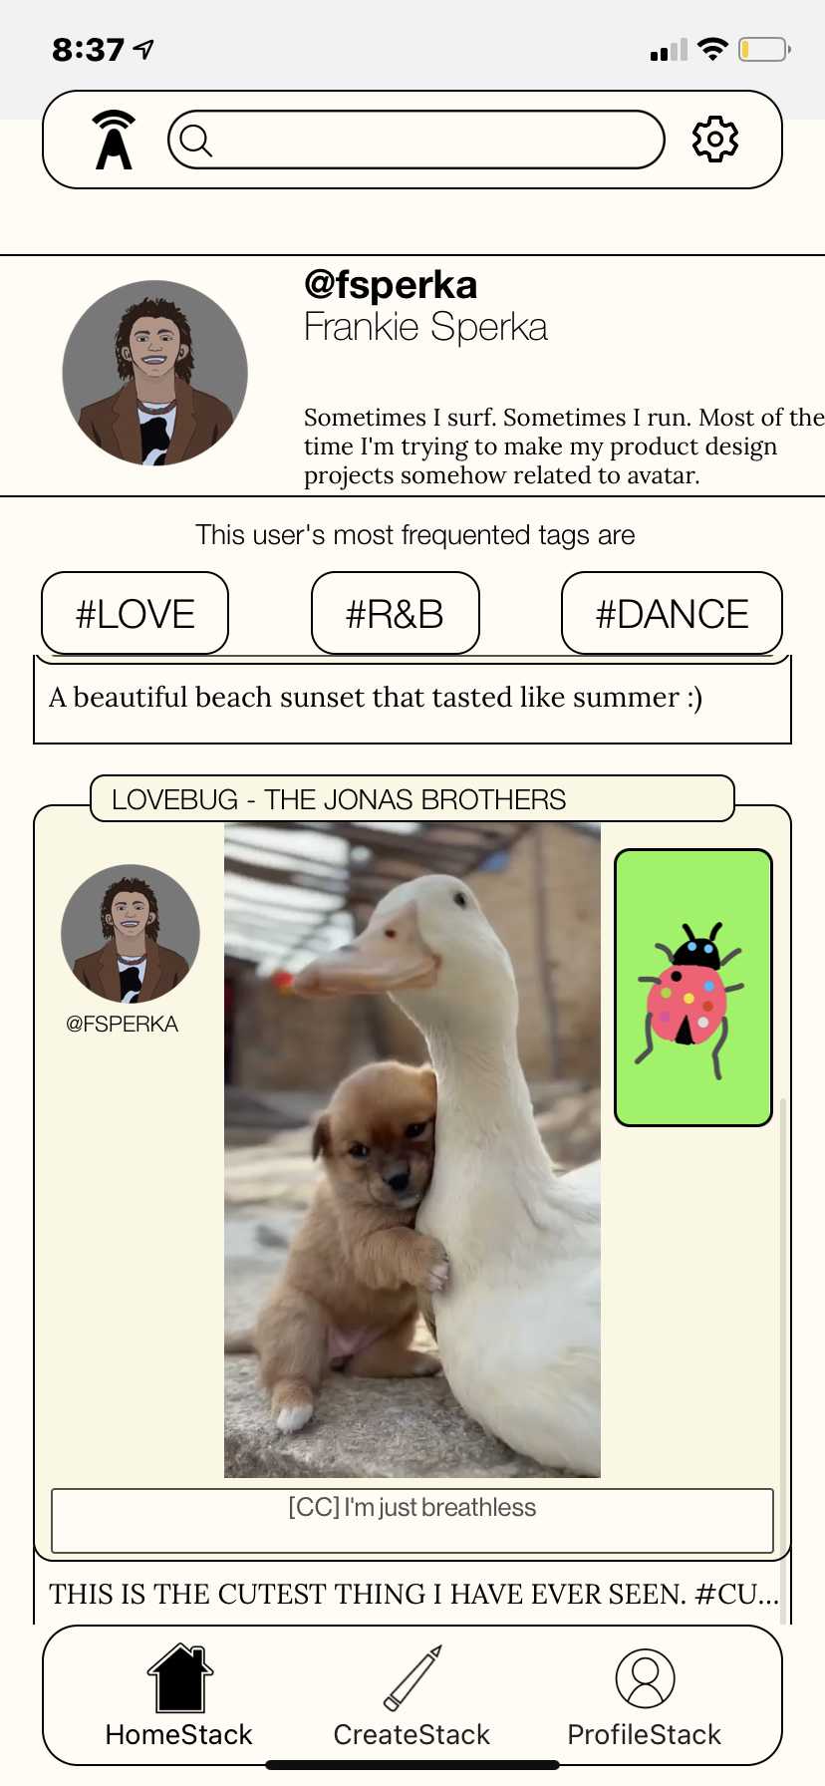
HI-FI TASK 3
COMPLEX TASK: INTERACTING WITH ALTiOs, PROFILES, AND TAGS
ON SCROLL

Slide 22
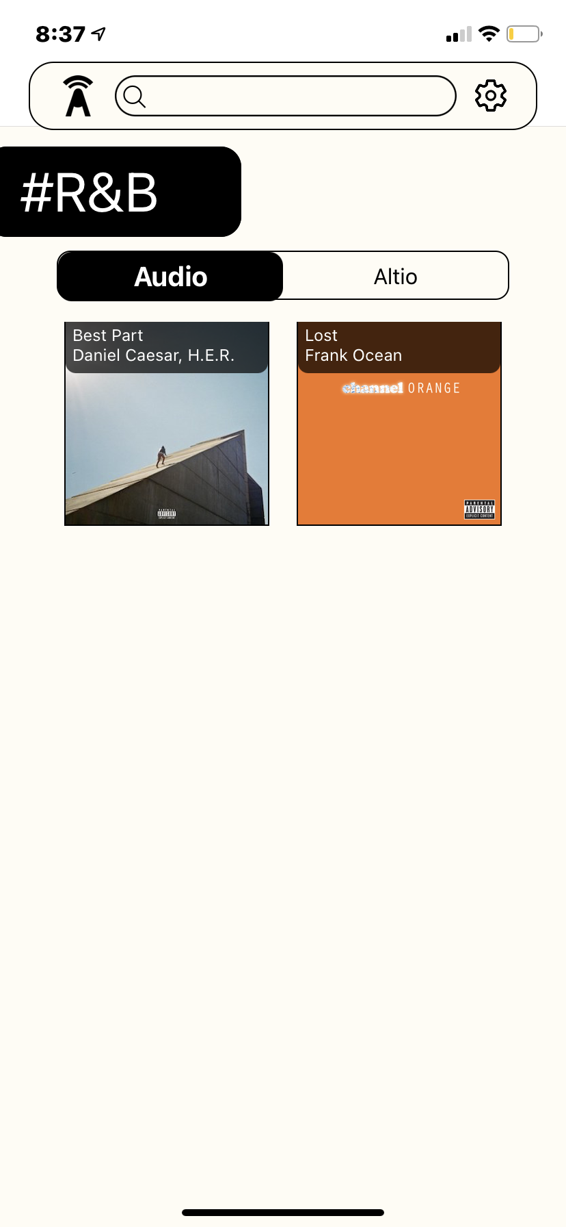
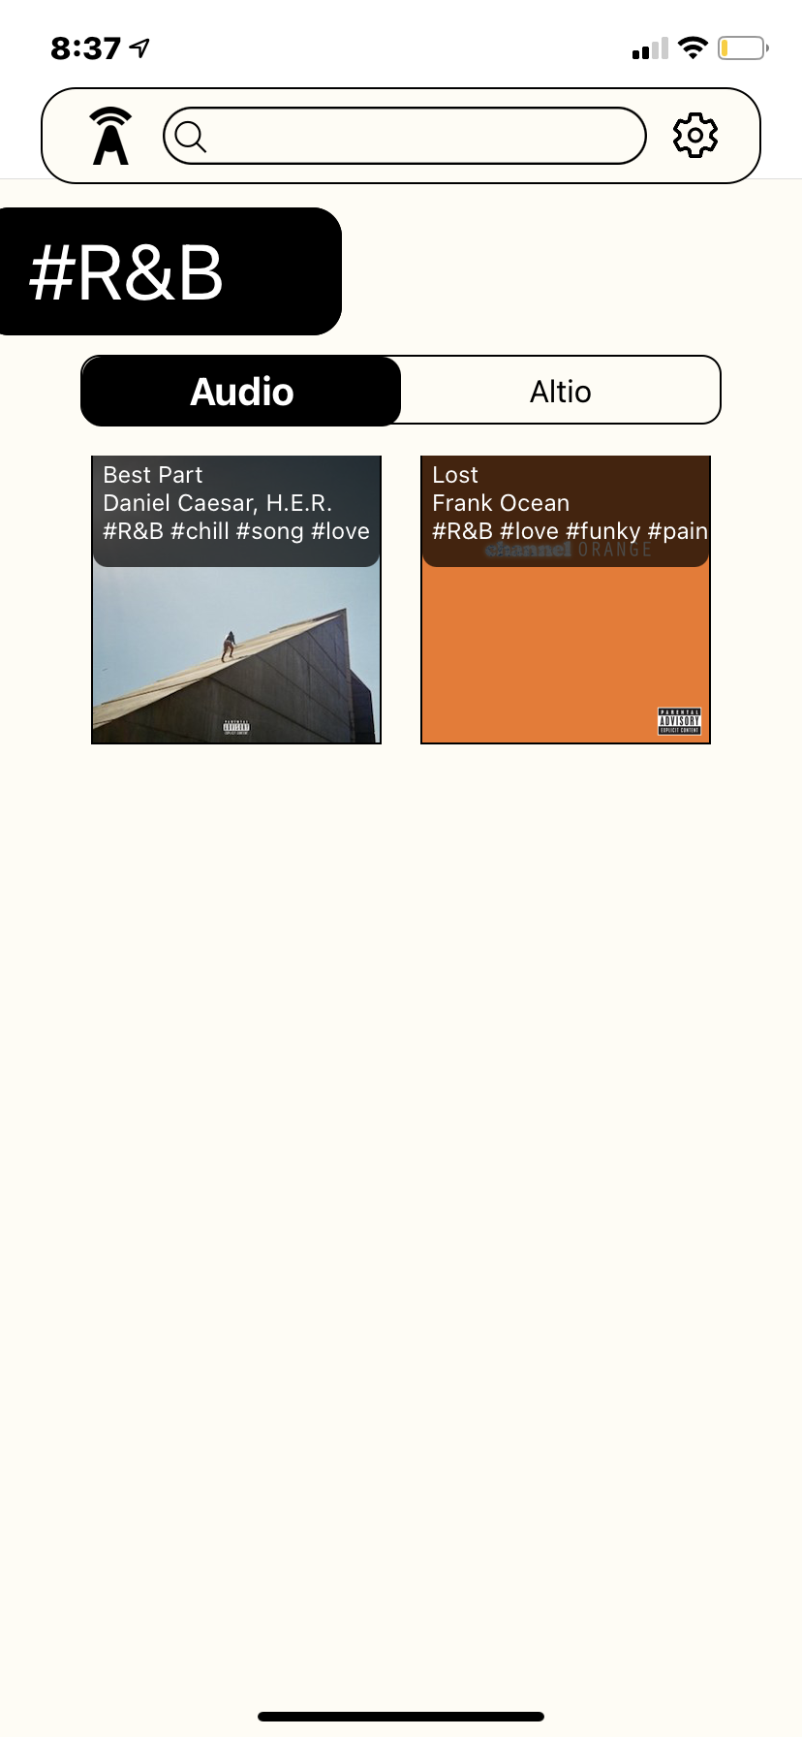
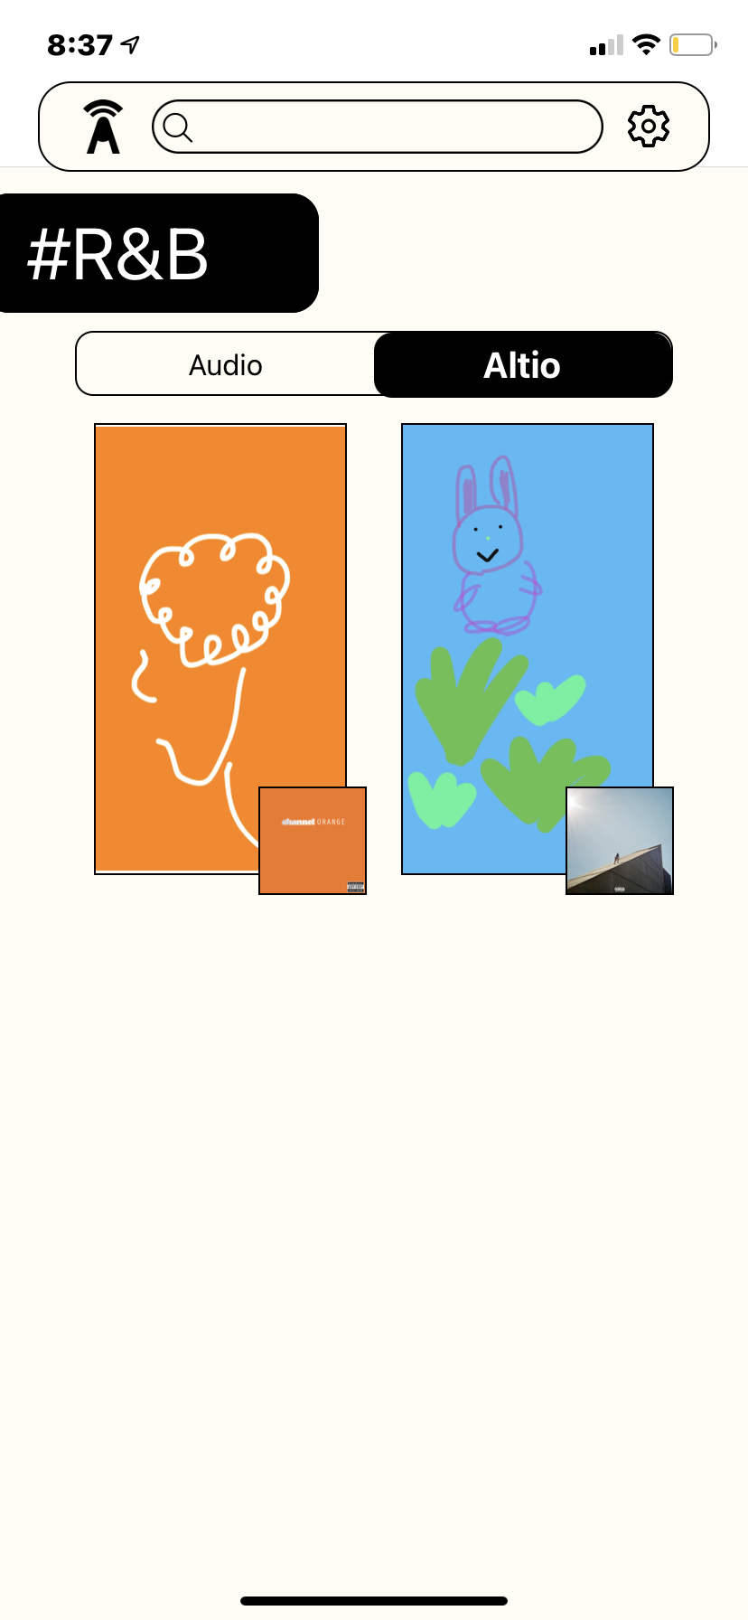
HI-FI TASK 3
COMPLEX TASK: INTERACTING WITH ALTiOs, PROFILES, AND TAGS

Slide 23
HI-FI UNIMPLEMENTED
Social network features of a post:
‘Like’, ‘Comment’, ‘Explanation’ buttons
Onboarding sequence
“Create” sequence:
Choosing and uploading audio, explaining and captioning post
Search screen
Settings screen

Slide 24
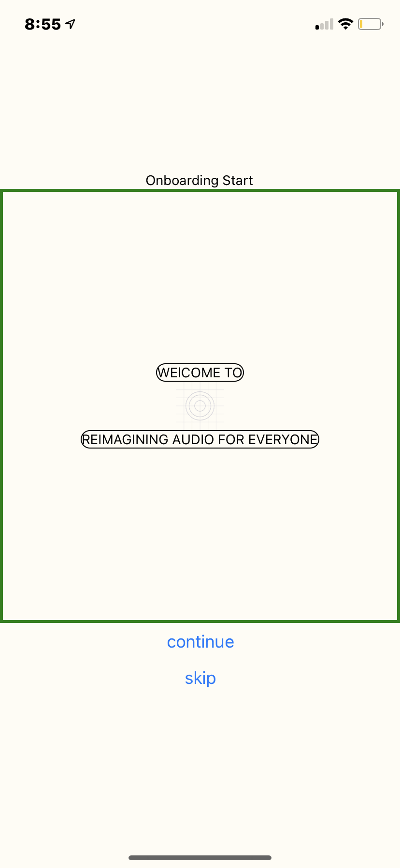
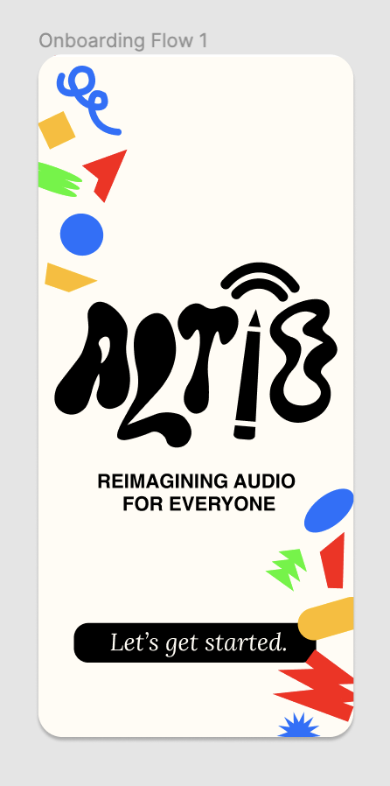
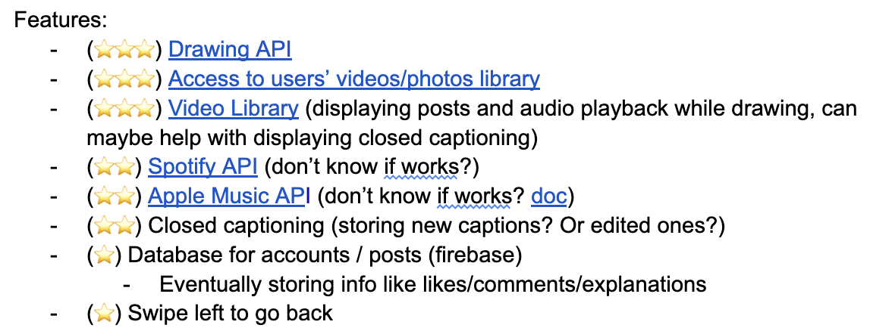
HI-FI NEXT STEPS
The main steps we need to take from here are implementation of the Create features and syncing the design of our native app to our Figma documentation.

Slide 25
HI-FI DEMO

Slide 26
SUMMARY
RICH SOCIAL MEDIA EXPERIENCE
BOGGED DOWN BY THE HIGH-LEVEL IDEA/GOAL
INCREASING CLARITY WITHIN SYSTEM E.G. ICONS
STREAMLINING PROCESS OF NAVIGATING THE APP E.G. “CREATE”
DIFFERENTIATING AND EXPLAINING FEATURES

